Slide 1
Lesson 85: Systems of Nonlinear Equations

Slide 2
We know that the graph of a first-degree polynomial equation in two unknowns is a straight line. Each of the variables in the following equation has an understood exponent of 1, so this equation is a first-degree equation. Also, the equation has two unknowns, thus the equation has a straight line as its graph.
y = 2x – 4

Slide 3
The following equation is also a first-degree polynomial equation, but it has three unknowns. The graph of this equation is not a line but a plane, because the presence of three unknowns requires that we use three dimensions to picture it. Nonetheless, we still call this equation a linear equation, for we give this name to any first-degree polynomial equation that has two or more unknowns.
3x – 2y + z = 17

Slide 4
This is the reason that the following equations can be called linear equations even though each has more than three unknowns.
4x + 2y – 3z – 6k = 14
3x + 7y – 2z – 6p + 3m – n = 21

Slide 5
Equations that have variables at least one of whose exponents is not 1, such as
x + y = 5 or x + y = 7
And equations in which some terms are products of variables, such as
xy = 4 and 4x – xy = 7
Have graphs that are not straight lines, and thus we call these equations nonlinear equations.
2 2 2

Slide 6
The most important nonlinear figures are called conic sections because they can be formed by a plane cutting a single right circular cone or a double right circular cone.
The following four figures show how a plane can cut a right circular cone to form conic sections and two typical equations for each section are given.

Slide 7
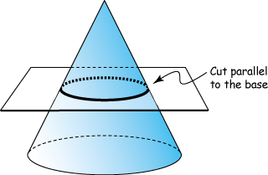
Circle:
x + y = 6
2x + 2y = 15
2 2
2 2

Slide 8
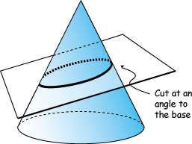
Ellipse:
2x + 3y = 17
x + 5y = 5
2 2
2 2

Slide 9
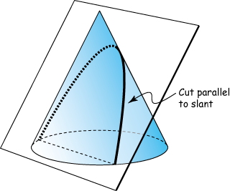
Parabola
y = x – 10x + 23
y = 3x - 5
2
2

Slide 10
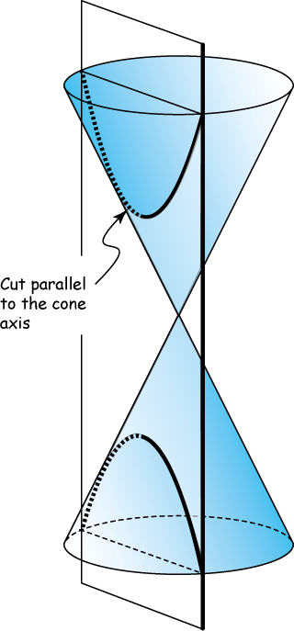
Hyperbola:
x – 4y = 4
4x – 2y = 6
2 2
2 2

Slide 11
It is interesting to note that if the plane is tangent to the cone, the set of points where the plane and the cone would touch would form a straight line; for this reason, the straight line can also be considered to be a conic section.

Slide 12
A nonlinear system of equations is a system in which at least one of the equations is a nonlinear equation. These systems often have more than one solution, because the graphs intersect in more than one point.

Slide 13
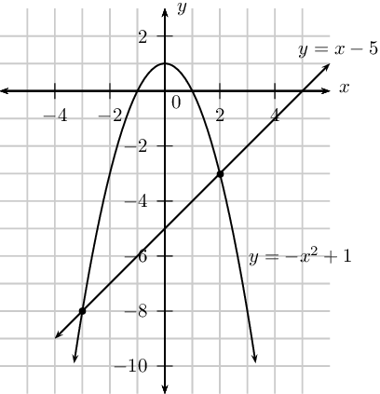

Slide 14
To solve systems of nonlinear equations, we use the substitution method and the elimination method just as we have done to solve systems of linear equations.

Slide 15
Example:
Solve the system:
x + y = 9
2x – y = 3
2 2

Slide 16
Answer:
(0, -3) and (12/5, 9/5)

Slide 17
Example:
Solve the system:
BT + 5T = 25
BT – 5T = 15
D D
D D

Slide 18
Answer:
B = 20
T = 1
D

Slide 19
HW: Lesson 85 #1-30

