Slide 1
Bell Work:
Describe each sequence as arithmetic, geometric or neither.
1, 2, 4, 8, 16….
2, 4, 6, 8, 10….
1, 4, 9, 16, 25….

Slide 2
Answer:
Geometric
Arithmetic
Neither

Slide 3
Lesson 62: Graphing Solutions to Inequalities on a Number Line

Slide 4
Tom is thinking of a number between 1 and 10. Of what possible numbers could he be thinking?

Slide 5
We might assume that Tom is thinking of a counting number greater than 1 and less than 10, such as 3, 6 or 7. However, Tom could be thinking of 2 ½ or π or √20, because each of these numbers is also between 1 and 10.

Slide 6
We can write an inequality to indicate the range of possible numbers. Letting x represent a possible number, we write
1 < x < 10
We read this inequality in both directions from x, “x is greater than 1 and less than 10.” notice that both the description and the inequality exclude 1 and 10.

Slide 7
We can use a number line to graph the possible numbers of which Tom could be thinking.
○
○

Slide 8
The shaded portion of the number line represents the range of choices for Tom’s number. The word between suggests that Tom’s number is greater than 1 and less than 10, so the small circles at 1 and 10 indicate that those numbers are excluded from the choices. To show that those numbers are included we make a shaded dot.

Slide 9
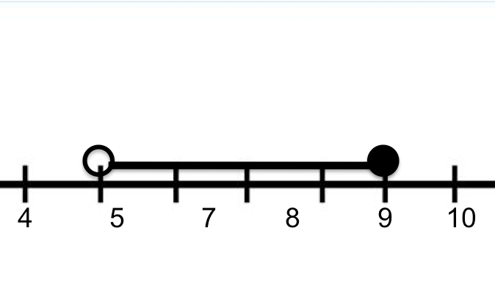
Greater than 5 and less than or equal to 9
5 < x ≤ 9

Slide 10
Example:
Christina is thinking of a number. If she doubles the number, the product is greater than 4. write an inequality for this description. Graph on a number line all the possible choices for her number.

Slide 11
Answer:
2x > 4
“twice the number is greater than 4”
x > 2
○

Slide 12
Example:
Solve and graph the solution to this inequality:
3x + 1 ≤ 7

Slide 13
Answer:
x ≤ 2
•

Slide 14
Practice:
Vincent goes to the store with $20 to buy a notebook for $4. he notices that packages of notebook paper are on sale for $2. write and solve an inequality to show the number of packages of notebook paper he could buy if he also buys the notebook(ignoring sales tax). Then graph the solution.

Slide 15
Answer:
2p + 4 ≤ 20
p ≤ 8
•

Slide 16
Practice:
Solve and graph the solution:
3 ≤ x – 2

Slide 17
Answer:
5 ≤ x
•

Slide 18
HW: Lesson 62 #1-30

