Slide 1
Bell Work:
Use cross products to solve the proportion.
0.8 = 5
z 1.5

Slide 2
Answer:
z = 0.24

Slide 3
Drawing Geometric Solids

Slide 4
Polyhedron*: a general term that identifies a solid with faces that are polygons.
A polyhedron has no curved surfaces or edges.

Slide 5
Visualize a three-dimensional solid for which each polygon could be a face or base.

Slide 6
Polyhedron | Faces | Vertices | Edges
Cube/Rectangular Prism | 6 Square or Rectangular | 8 | 12
Triangular Prism | 2 Triangular and 3 Rectangular | 6 | 9
Square/Rectangular Pyramid | 4 Triangular and 1 Square/Rectangular | 5 | 8
Triangular Pyramid | 4 Triangular | 4 | 6

Slide 7
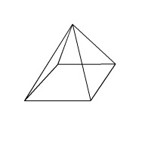
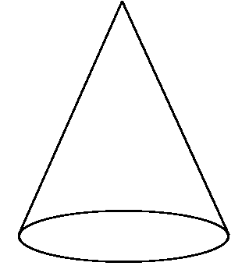
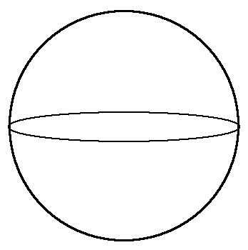
Geometric Solids
Prism |  | A type of polyhedron with parallel congruent bases.
Pyramid |  | A type of polyhedron with lateral surfaces that narrow to a point (apex).
Cylinder |  | Refers to a right circular cylinder.
Cone |  | Refers to a right circular cone.
Sphere |  | A smooth curved solid every point of which is the same distance from its center.

Slide 8
Page 272.
1. A triangular prism has how many faces, edges, and vertices?

Slide 9
Answer:
5 faces, 9 edges, and 6 vertices.

Slide 10
2. Name each figure. Which is not a polyhedron? Explain.

Slide 11
Answer:
Prism or Rectangular prism
Pyramid
Cone
Prism or Triangular prism
C is not a polyhedron because it is curved.

Slide 12
Activity 1:
Sketch a rectangular prism, a triangular prism, and a cylinder using parallel projection. Make the bases of each figure congruent. Show hidden edges with dashes. To sketch the figures from different viewpoints, shift the position of the more distant base.

Slide 13
Activity 2: sketch a few pyramids and cones from different viewpoints.

Slide 14
Activity 3: divide your paper into four equal sections. In the isometric section copy the sketch below. Then draw the top, front and side views.

Slide 15
Activity 4:
Create one-point perspective drawings of some prisms. Place the vanishing point in different locations to change the point of view. Try different polygons for the bases of the prisms.

Slide 16
Lesson 45: Ratio Problems Involving Totals

Slide 17
Some ratio problems require us to consider the total to solve the problem. For these problems we add a third row for the total to our ratio table.

Slide 18
Example:
Acrobats and clowns converged on the center ring in the ratio of 3 to 5. if a total of 24 acrobats and clowns performed in the center ring, how many were clowns?

Slide 19
Answer:
5/8 = c/24
c = 15
15 Clowns
Ratio | Actual Count
3 | a
5 | c
8 | 24

Slide 20
Example:
A bus company has small and large buses in the ratio of 2 to 7. if the company has 84 large buses, how many buses does it have?

Slide 21
Answer:
7/9 = 84/t
7t = 9(84) t = 108
Ratio | Actual Count
2 | s
7 | 84
9 | t

Slide 22
HW: Lesson 45 #1-30

