Slide 1
Bell work:
What is the lateral surface area of a tissue box with the dimensions shown?
4 inches
5 inches
9 inches

Slide 2
Answer:
112 inches squared

Slide 3
Lesson 44: Solving Proportions Using Cross Products, Slope of a Line

Slide 4
We have solved proportions by finding equivalent ratios just as we found equivalent fractions. To solve some proportions it is helpful to use another method. In this lesson we will practice using cross products to solve proportions.

Slide 5
Cross Product*: the result of multiplying the denominator of one fraction and the numerator of another fraction.

Slide 6
A characteristic of equal rations is that their cross products are equal.
¾ = 6/8
8 x 3 = 24 4 x 6 = 24

Slide 7
If we know that two ratios are equal, we can use cross products to help us find an unknown term in one of the ratios.
4/6 = 6/n
4n 6 x 6
4n = 6 x 6
n = 9

Slide 8
Example:
Solve using cross products:
m/10 = 15/25

Slide 9
Answer:
25m = 10 x 15
m = 6

Slide 10
In lesson 41 we graphed lines to illustrate the relationship between two variables. Lines on a coordinate plane may be horizontal, vertical, or slanted one way or the other. We use a number called the slope to indicate the steepness of the line and whether the line is slanted “uphill” (positive) or “downhill” (negative).

Slide 11
Slope*: the slope of a line is the ratio of the rise to the run between any two points on the line.
Slope = rise/run

Slide 12
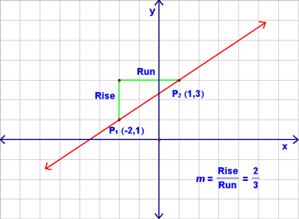

Slide 13
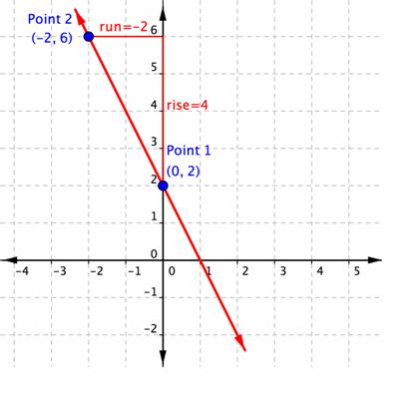

Slide 14
The run starts from a point on the line and moves over to the right or left.
The rise starts at the end of the run and moves up or down to meet the line.

Slide 15
Train your eyes to read lines on graphs from left to right like you read words.
“Uphill” lines have a positive slope.
“Downhill” lines have a negative slope.

Slide 16
Note that the slope of a horizontal line is zero. We do not assign a slop to a vertical line. Instead we say the the slop of a vertical line is undefined.

Slide 17
Two points on a graph represent an interval. The slope between the two points is the average rate of change of one variable relative to the other in that interval.

Slide 18
Example:
Derek drives the highway at a steady rate, noting the time and distance he has traveled. This graph describes the distance Derek travels when driving at a constant rate of 50 mph. Find the average rate of change in miles per hour Derek drives over these three intervals: zero and 1 hour, 1 hour and 3 hours, and 3 hours and 4 hours.

Slide 19
Answer:
50 miles/1 hour = 50 mph
100 miles/2 hour = 50 mph
50 miles/1 hour = 50 mph

Slide 20
Notice that if a function is linear (the points are aligned as on the previous graph), then the slope between any two points is constant.

Slide 21
HW: Lesson 44 #1-30

