Slide 1
Lesson 32: Quotient Theorem for Square Roots, Congruency, Congruent Triangles

Slide 2
We remember that the square root of a product can be written as the product of the square roots of its factors.
√(3 • 2) = √3√2

Slide 3
A similar rule applies to the square root of a quotient (fraction), for the square root of a quotient can be written as a quotient of square roots.
√(3/2) = √3/√2

Slide 4
It is customary to rationalize the denominators of expressions that have radicals in the denominator. In the expression we can rationalize the denominator by multiplying by √2 over √2. this fraction has a value of 1, and the multiplication changes the denominator from the irrational number √2 to the rational number 2.
√(3/2) = (√3/√2) • (√2/√2) = √6/2

Slide 5
Example:
Simplify
√(3/7)

Slide 6
Answer:
√21/7

Slide 7
Example:
Simplify
√(2/5) + √(5/2)

Slide 8
Answer:
7√10
10

Slide 9
Example:
Simplify
2 √(2/7) – 5 √(7/2)

Slide 10
Answer:
31√14
14

Slide 11
Congruent: geometrically equal.
If we can mentally cut out one geometric figure, rotate it or flip it as necessary, and place it on another geometric figure so that it fits exactly, the two figures are congruent.

Slide 12
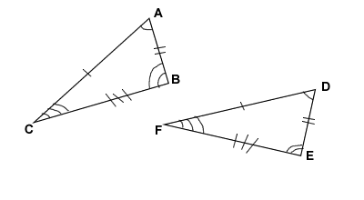
When we write the statement of congruency, we are careful to list vertices whose angles are equal in the same order.
ΔABC ≅ ΔDEF

Slide 13
Congruent triangles are similar triangles whose scale factor is 1.
We can also say that congruent parts of congruent triangles are congruent.

Slide 14
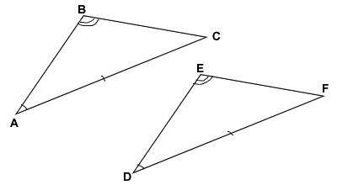
Example:
Find x and p.
6
6
4x + 1
6x + 2
p
12x – 4

Slide 15
Answer:
x = 1
p = 5

Slide 16
HW: Lesson 32 #1-30

