Slide 1
Lesson 31: Negative Reciprocals, Perpendicular Lines, Remote Interior Angles

Slide 2
We remember that the reciprocal of a number is the number in inverted form.
Thus 2/5 is the reciprocal of 5/2, -1/4 is the reciprocal of -4.

Slide 3
We note that the sign of a number is the same as the sign of its reciprocal. This is not true for numbers that are negative reciprocals, because each of these numbers is the inverted form of the other and the signs of the numbers are different.
Thus, -2/5 is the negative reciprocal of 5/2. 4 is the negative reciprocal of -1/4.

Slide 4
We recall that parallel lines have equal slopes and different y-intercepts.
y = -1/2x + 2
y = -1/2x – 3
These lines are parallel because the coefficient of the x term in both of the equations is the same.

Slide 5
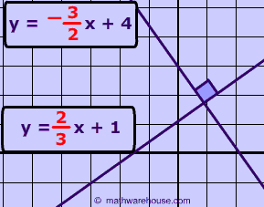
The slopes of lines that are perpendicular are negative reciprocals of each other.

Slide 6
Example:
Write the equation of the line that is perpendicular to y = 2/5x – 3 and passes through the point (3, 2).

Slide 7
Answer:
y = -5/2x + 19/2

Slide 8
A polygon has one interior angle at each vertex. A polygon has two exterior angles at each vertex. An exterior angle is formed by extending one side of the polygon.
B E
C
E
A

Slide 9
The exterior angles are equal angles because they are vertical angles. We can prove that the measure of each of these exterior angles equals A + B. Because A and B are on the other side of the triangle from the angle labeled E, these interior angles are called remote interior angles.

Slide 10
Example:
Prove that the measure of an external angle of a triangle equals the sum of the measures of the remote interior angles.

Slide 11
Answer:
A + B + C = 180
C + E = 180
A + B + C = C + E
A + B = E

Slide 12
HW: Lesson 31 #1-30

