Slide 1
Lesson 24: Fractional Equations, Overlapping Triangles

Slide 2
We can eliminate fractions by multiplying every numerator by the least common multiple of the denominators. Then the denominators will divide into the LCM, leaving the equation with integral coefficients.

Slide 3
Example:
Solve
4 ½ x – 3/5 = -1 ¼

Slide 4
Answer:
9/2x – 3/5 = -5/4
LCM = 20
x = -13/90

Slide 5
Example:
Solve
4x + 2 - 3 = 1
5 2 3

Slide 6
Answer:
LCM = 30
x = 43/24

Slide 7
Example:
Solve
3x + 8 – 4x = 3
2 7

Slide 8
Answer:
LCM = 14
x = 2

Slide 9
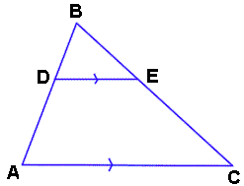
Sometimes the same angle can be an angle in two or more triangles.

Slide 10
Overlapping triangles are also similar triangles.

Slide 11
Example:
Find x and y.
X
7
Y
9
4 6

Slide 12
Answer:
x = 21/2
y = 45/2

Slide 13
HW: Lesson 24 #1-30

