Slide 1
Lesson 122: Laws of Logs, intersections of sets, union of sets, venn diagrams

Slide 2
We remember that logarithm is just an exponent. We know that 100 equals 10 , so the logarithm of 100 to the base 10 is 2. We know that 1000 equals 10 , so the logarithm of 1000 to the base 10 is 3.
2
3

Slide 3
2 3 2 + 3
Because (10 )(10 ) equals 10 we say
log [(100)(1000)] = log 100 + log 1000
If we let b represent the base, let M represent 100, and let N represent 1000, we can write a general statement of the rule for the logarithm of a product.
If b = M and b = N we say
log (MN) = log (M) + log (N)
Because (b )(b ) = b
10 10 10
a c
b b b
a c a + c

Slide 4
To use numbers to illustrate the rule for logarithm of a quotient, we can write:
10 /10 = 10
Because we say
log 100000/1000=log 100,000 – log 1000
We can use letters to write a general rule for the logarithm of a quotient.
If b = M and b = N, we say
log M/N = log M – log N
Because b /b = b
5 3 5 – 3
10 10 10
a c
b b b
a c a – c

Slide 5
To use numbers to illustrate the rule for the logarithm of a power, we can write:
(10 ) = 10
Because we say
log (100) = 4 log 100
If we use letters to write a general rule for the logarithm of a power and if b = M, we say
log M = x log M
Because (b ) = b
2 4 2(4)
4
10 10
a
x
b b
a x ax

Slide 6
Intersection of sets:
If we have the two sets
A = {1, 2, 3, 6, 7} B = {1, 3, 8, 9}
We see that the numbers 1 and 3 are members of both sets. We say the set {1, 3} is the intersection of sets A and B. if we use the symbol to represent the word intersection, we can write
A B = {1, 3}
This is read as the intersection of sets A and B and often as A intersection B.
We see that the intersection of two sets is the set whose members are members of both of the given sets.

Slide 7
Example:
Given P = {1, 2, 3, 4, 7, 9, 13} and K = {2, 5, 7, 8, 10, 13, 15}, P K.

Slide 8
Answer:
{2, 7, 13}

Slide 9
If we look at sets A and B
A = {1, 2, 3, 7} B = {1, 3, 8, 9}
And list all the members of both sets, we would write
1, 2, 3, 7, 8, 9
If we list these numbers using set notation, we would write
{1, 2, 3, 7, 8, 9}
For we only write a number once when we use set notation. This set is called the union of sets A and B and consists of all the members of set A and all the members of set B, none listed more than once. We use the symbol to represent the word union.
A B = {1, 2, 3, 7, 8, 9}

Slide 10
Example:
Given P = {1, 2, 3, 4, 7, 9, 13} and K = {2, 5, 7, 8, 13, 15}, find P K.

Slide 11
Answer:
{1, 2, 3, 4, 5, 7, 8, 9, 13, 15}

Slide 12
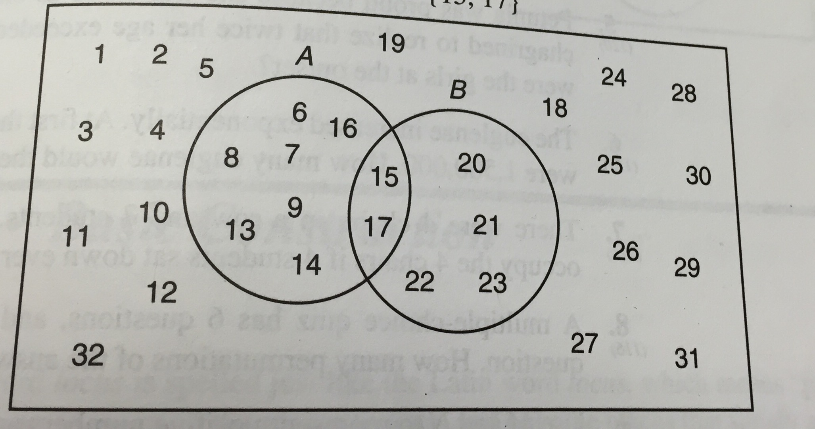
Diagrams can be used to enhance our understanding of intersection and union. In the diagram we have designated set A by drawing a circle around the members of this set. We have also circled the members of set B. we can see that the numbers 15 and 17 are members of both set A and set B, so these numbers are the intersection of sets A and B.

Slide 13
The union of sets A and B consists of all the members of both sets. Thus, we can write
{6, 7, 8, 9, 13, 14, 15, 16, 17, 20, 21, 22, 23}

Slide 14
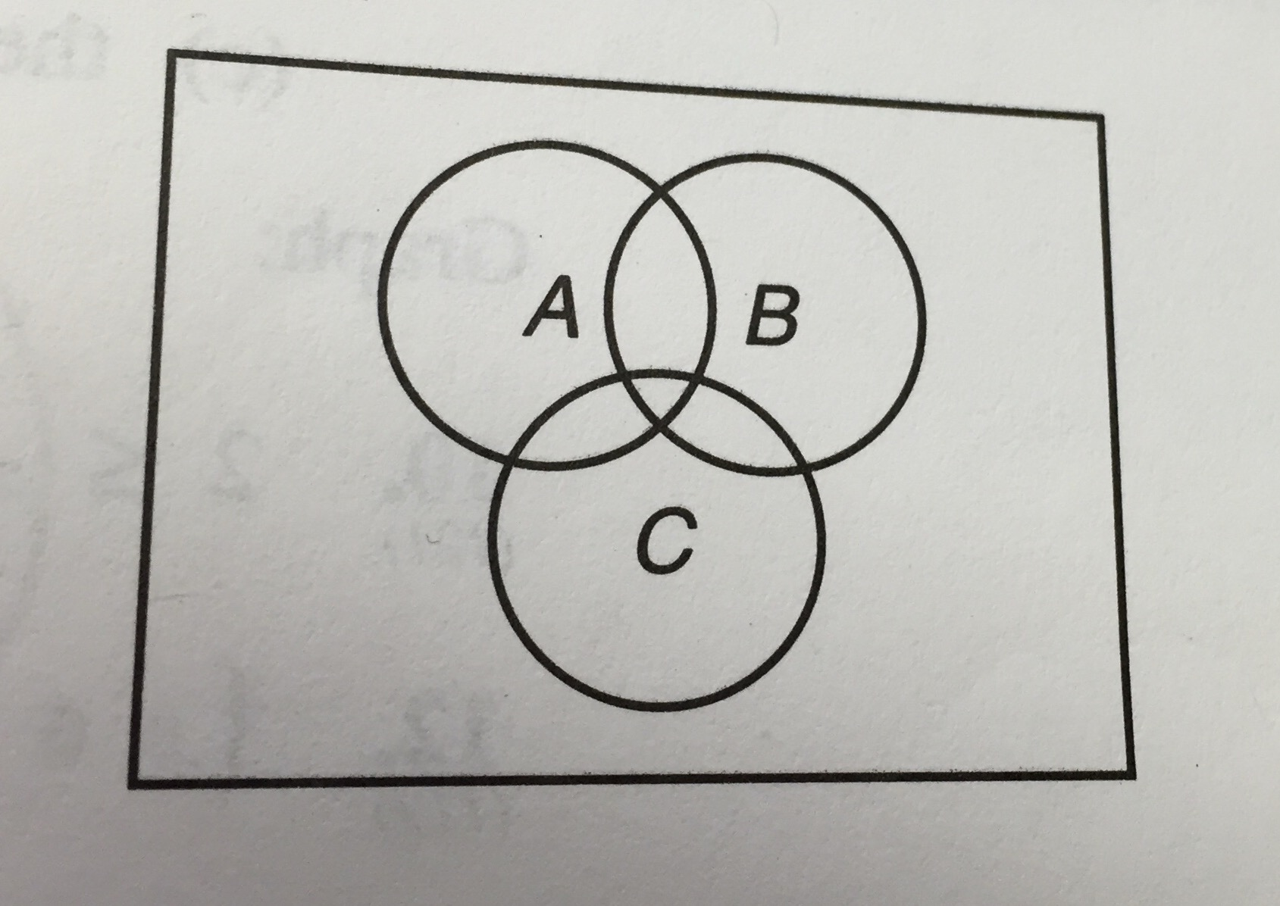
Example:
The circles contain the members of sets A, B, and C, as indicated. Designate the areas that represent:
A B
B C
B C

Slide 15
Answer:

Slide 16
HW: Lesson 122 #1-30

