Slide 1
Lesson 100: Graphs of Parabolas

Slide 2
We remember that a polynomial equation in one variable in which the highest power of the variable is 2 is called a quadratic equation. If we set the expression equal to y, we will have written special kinds of quadratic equations that define quadratic functions.
y = x + 4x + 4
y = -x + 4x – 3
y = x - 3
2
2
2

Slide 3
These equations can be graphed, because we can assign values to x and find the resulting values for y. any function can be graphed by using the laborious method of assigning many values to x and finding the resulting values for y. we call the graph of a quadratic equation a parabola.

Slide 4
If we graph many, many quadratic equations, we will find that the following relationships between the function and the graph of the function are always true.

Slide 5
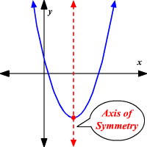
1. Every parabola is symmetric about some vertical line. This vertical line is called the axis of symmetry.

Slide 6
2. Every parabola opens upward or it opens downward. If the coefficient of x is a positive number, the graph opens upward. If the coefficient of x is a negative number, the graph opens downward. This is true regardless of the values of the other numbers in the equation.
2
2

Slide 7
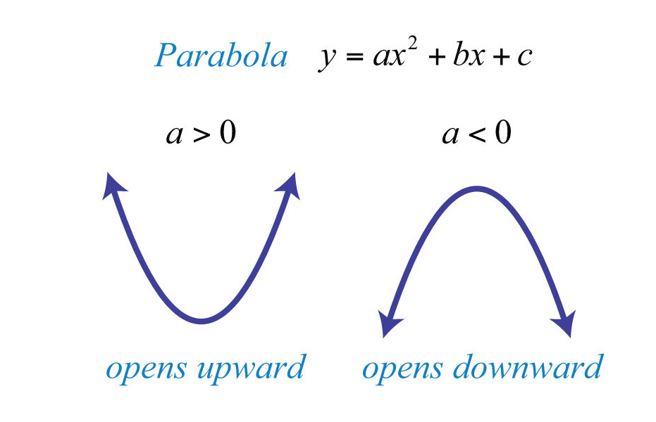

Slide 8
3. The parabola crosses the y-axis at the value of the constant term in the equation. This is because the value of x is zero on the y-axis. If we let x equal zero, all terms that contain x equal zero and all that is left is the constant term.

Slide 9
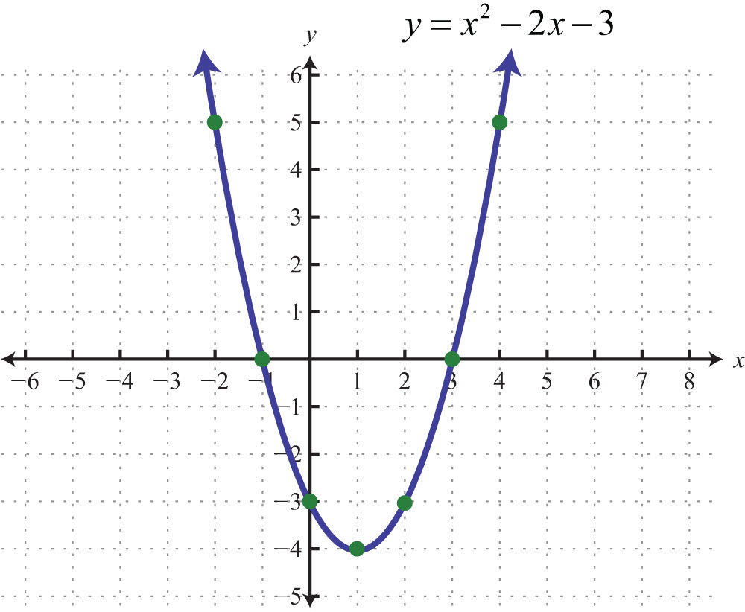

Slide 10
We will complete the square of quadratic equations to determine the axis of symmetry and the coordinates of the vertex.

Slide 11
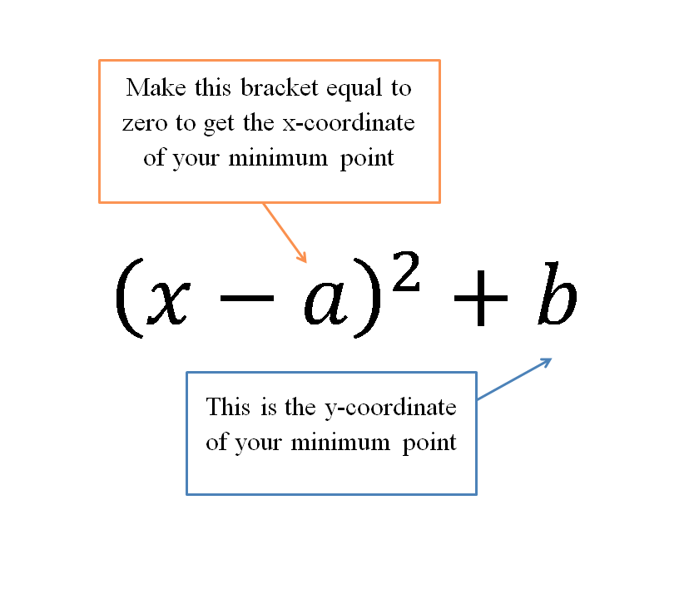

Slide 12
Example:
Complete the square to graph
y = x – 4x + 2
2

Slide 13
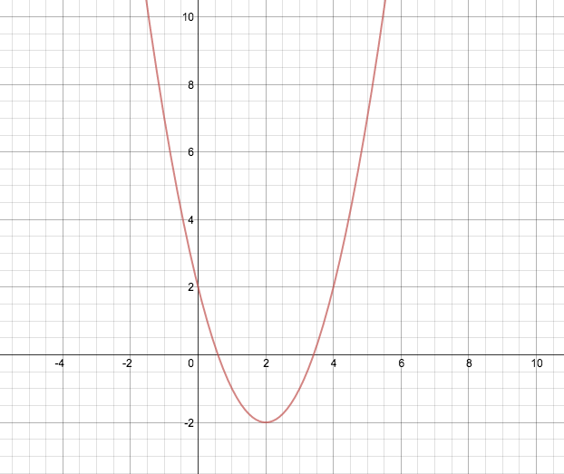
Answer:

Slide 14
Example:
Complete the square to graph
y = -x + 2x + 2
2

Slide 15
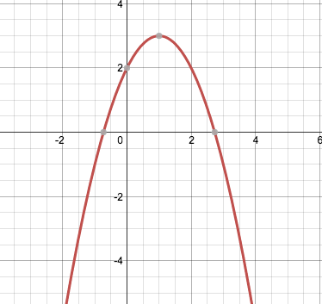
Answer:

Slide 16
Example:
Complete the square to graph
y = -x – 6x – 8
2

Slide 17
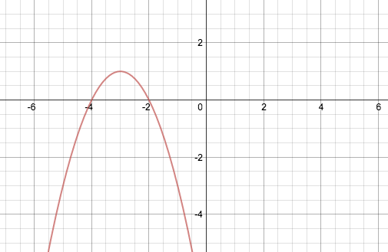
Answer:

Slide 18
HW: Lesson 100 #1-30

